Slide 1
CSE2006 MICROPROCESSOR AND INTERFACING J COMPONENT REVIEW – 2 PROF . BALAMURUGAN M S
PROJECT TITLE : CONTROLLING VLC MEDIA PLAYER THROUGH HAND GUESTURE
TEAM MEMBERS :
TARUN A H 18BCE1213
LOKESH KRISHNAN 18BCE1239

Slide 2
CONTENTS
ABSTRACT
COMPONENTS REQUIRED
SOFTWARES REQUIRED
WORKING METHODOLOGY
MODULES IN THE PROJECT
GESTURES DESCRIPTION
CIRCUIT DIAGRAM

Slide 3
ABSTRACT
This project deals with controlling VLC media player using hand guesture. Hence, by using our project , hand gesture feature can be easily added on to any laptops .
The hand can be detected using 2 Ultrasonic sensors ( One for left hand and one for right hand ).
The ultrasonic sensor passes information to the Arduino . The Arduino encodes the information sent by the sensors and sends it to python module using serial communication.
The python module ( PyautoGUI) decodes the serial information and performs the necessary actions.
The gestures can be customized to perform necessary actions.

Slide 4
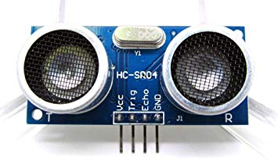
ComPONENTS REQUIRED
1. Ultrasonic Sensors ( 2 Nos.)
For detecting the hand (left and right) and passing the signal to Arduino UNO

Slide 5
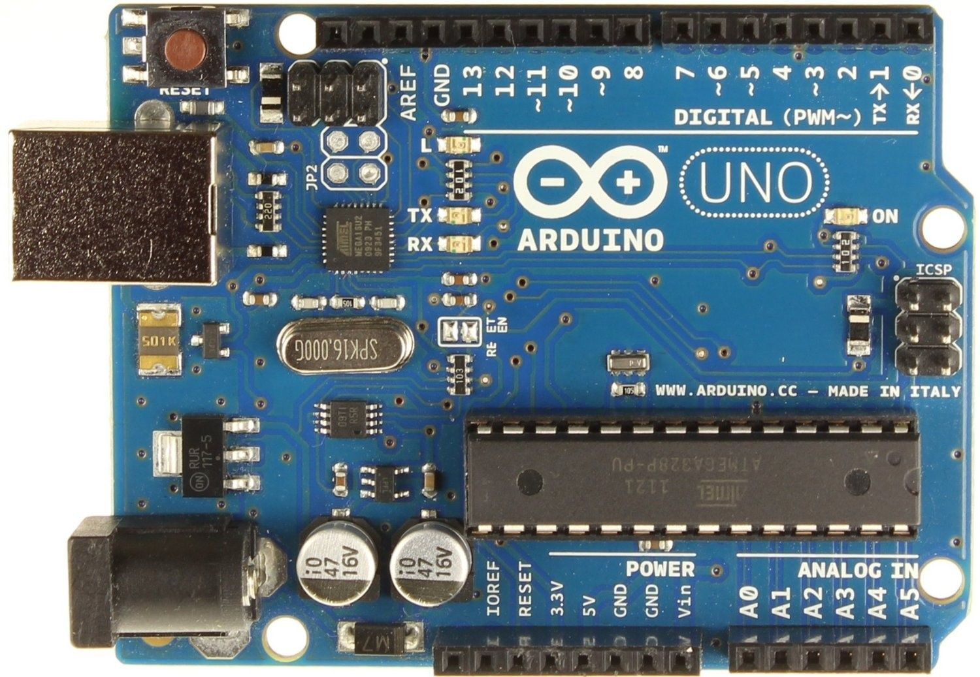
2. Arduino UNO BOARD :
It powers the ultrasonic sensors and receives the information from the sensors.
It encodes the received information and gets connected with the python via serial communication and sends it to the python module .
The python module decodes the information and performs the necessary actions.

Slide 6
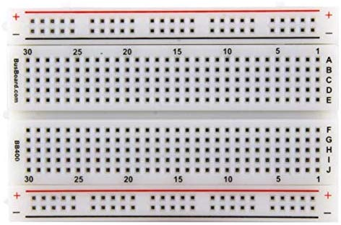
3. Breadboard :
For connecting ECHO , TRIG , VCC and GND pins of the two sensors with the VCC , GND and respective pins of ARDUINO .

Slide 7
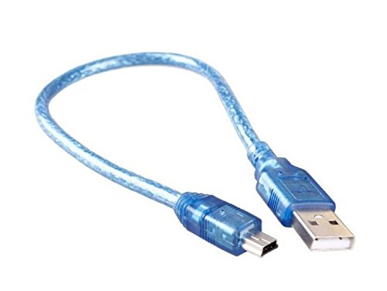
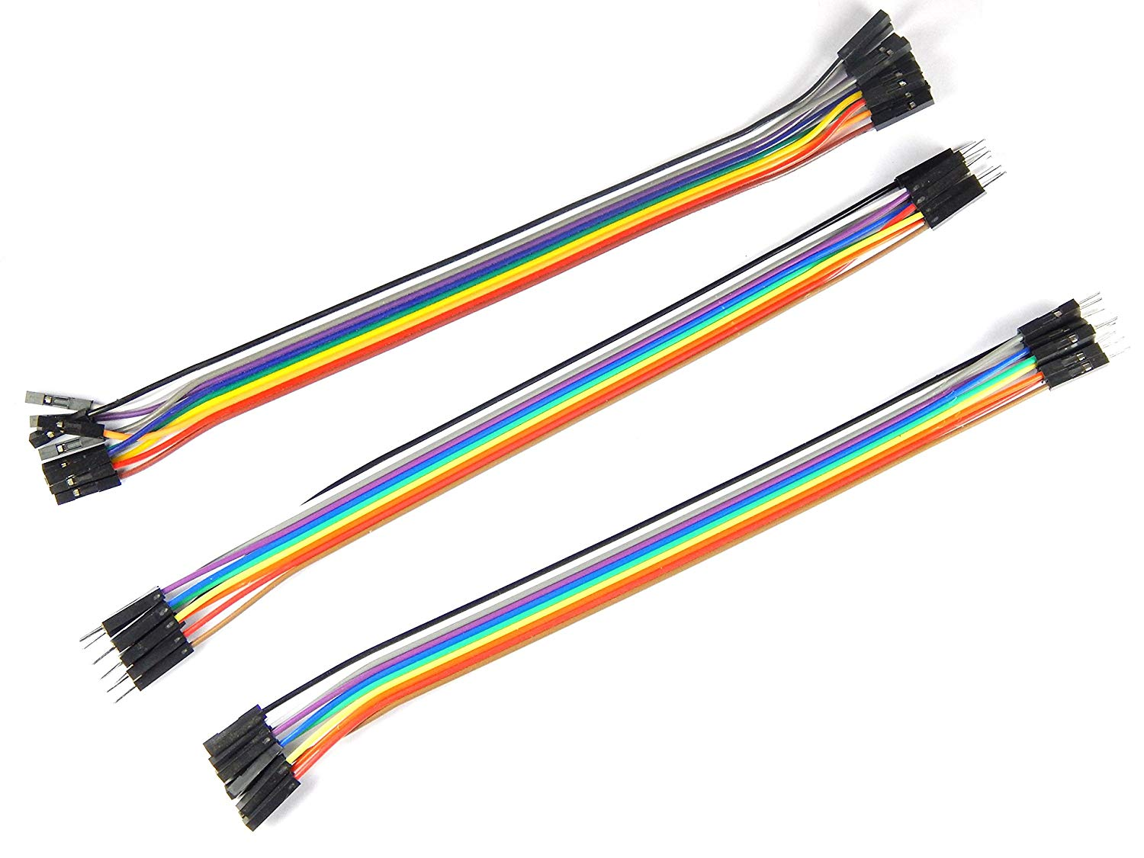
4. ARDUINO USB CABLE :
For powering the Arduino UNO board which in turn powers the sensors
5. Connecting wires :
For connecting the pins of Sensors with the appropriate slots in UNO board

Slide 8
SOFTWARES REQUIRED
ARDUINO IDE
PYTHON IDLE (3.8.1 32 – bit )
Pyserial library of Python
Pyautogui library of Python
Time library of Python ( comes along with the pyautogui library )

Slide 9
Working MethoDOLOGY
Ultrasonic sensors gets powered up when Arduino is connected to laptop
Arduino checks whether hand is held at a fixed position or constantly changing
Based on these conditions , Arduino encodes the string as ‘ Play / Pause , ‘Rewind’, ‘ Forward ‘ , ‘ Vol UP’ , ‘Vol Down’
Based on the decoded string , pyautogui module is called to perform the necessary keyboard action
Ultrasonic sensor senses the hand and passes information to arduino
It passes the encoded string to python module through serial communication
The python module receives the string and decodes the information
Arduino checks whether both the senosrs are enabled or only one

Slide 10

MODULAR APPROACH
MODULE 1 : Initial setting up of the Arduino uno board with the laptop .
This module covers the downloading of the ARDUINO IDE and setting up of the necessary PORT (COM PORT) and noting the appropriate Port number for serial communication . It also covers performing basic operations such as blinking LED experiment , etc. to check whether Arduino UNO is working or not

Slide 11
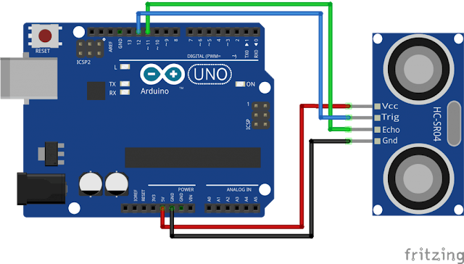
MODULE 2 : Connecting Ultrasonic sensors with Arduino UNO Board .
Connecting the ECHO , TRIG , GND and VCC pins of the SENSORS to the appropriate Pins of the Arduino and ensuring that the Arduino powers up the sensor , when Arduino is connected with the laptop through USB CABLE .

Slide 12
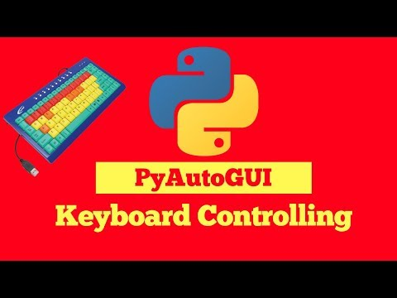
MODULE 3 : Connecting Arduino UNO with the python module .
This module covers the serial communication of Arduino UNO with python . It includes installing of python libraries such as :
Pyserial - For serial communication with ARDUINO UNO
PyautoGUI – For controlling the keyboard : It presses the necessary key for performing appropriate actions based on the information sent by the ARDUINO UNO.

Slide 13
MODULE 4 : Specifying the hand distance and programming the ARDUINO:
This module covers the programming part of ARDUINO UNO and ultrasonic sensors . The code specifies the distance of the hand from the monitor to be detected by the sensor . A check should also be placed on whether 2 sensors are getting enabled at the same time or only one sensor . A check should also be placed on whether the hand remains static at the same position or is getting moved toward or away from the monitor.
Based on this check , strings such as ‘Play/Pause’ , ‘Forward’ , ‘Rewind’, ‘Volume UP’ , ‘Volume Down’ are sent to the python module by the Arduino .

Slide 14
MODULE 5: Programming the Python module
This module covers programming the python module by importing the installed libraries . The port number and baud rate are specified for serial communication . It also decodes the information sent by the ARDUINO UNO .
For ex : If it receives ‘ Play / Pause ‘ , then spacebar is pressed by the pyautogui.
if it receives ‘Forward’ , then ctrl+R is pressed by the pyautogui .
The necessary action taken is printed on the output screen for verification .

Slide 15
MODULE 6 : Placing the hand over the monitor and verification :
The code is uploaded on to the ARDUINO UNO from ARDUINO IDE and compiled .
The python code is then compiled and start to RUN .
VLC media player is opened and video is started .
Hand is placed over the monitor and then gestures are evaluated .

Slide 16
GESTURES DESCRIPTION
Play / Pause : Placing both the hands at 40cm from the monitor
Forward : Placing right hand at 15cm from the monitor and moving towards the screen
Rewind : Placing right hand at 15cm from the monitor and moving away from the screen
Volume UP : Placing left hand at 15cm from the monitor and moving towards the screen
Volume Down : Placing left hand at 15cm from the monitor and moving away from the screen

Slide 17
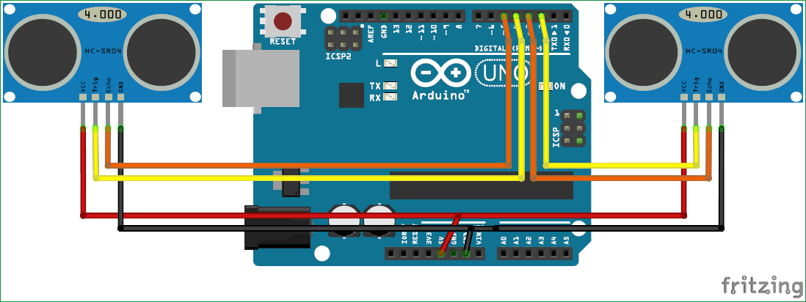
CIRCUIT DIAGRAM

Slide 18
PROJECT PLANNING
TIME – FRAME :
MODULE - 1 completed on 10th Feb 2020
MODULE – 2 completed on 12th Feb 2020
MODULE – 3 completed on 13th Feb 2020
MODULE – 4 done on 14th – 16th Feb 2020
MODULE – 5 completed on 18th Feb 2020
MODULE – 6 completed on 20th Feb 2020

Slide 19
REFERENCES
https://circuitdigest.com/microcontroller-projects/control-your-computer-with-hand-gestures
https://circuitdigest.com/microcontroller-projects/arduino-python-tutorial

